Slide 1
使用DIV来组织页面上的元素
Vocabulary: DIV, nesting, parent element, child element

Slide 2
DIV
<div>是用于包含其他元素的HTML元素。
Good dog
<div class="dog-container">
</div>
<div class="dog-container">
</div>
<h1>Good dog</h1>
<img src="dog.jpg">
Notes:
Teacher Notes
The yellow highlight on the left and right identify the boundaries of the div.
The <div> contains the <h1> and the <img>

Slide 3
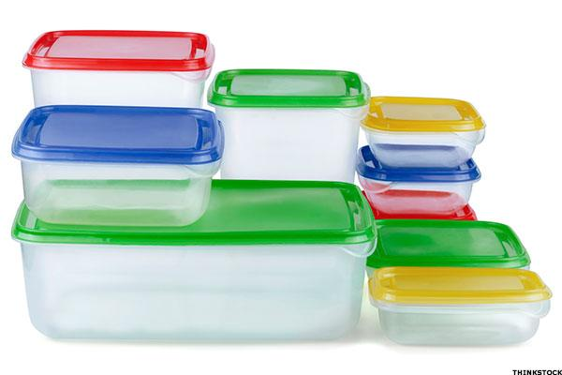
DIV
与其他元素（<h1>，<li>，<p>）不同，<div>没有默认样式。
它们就像容纳其他HTML元素的空盒子。

Slide 4
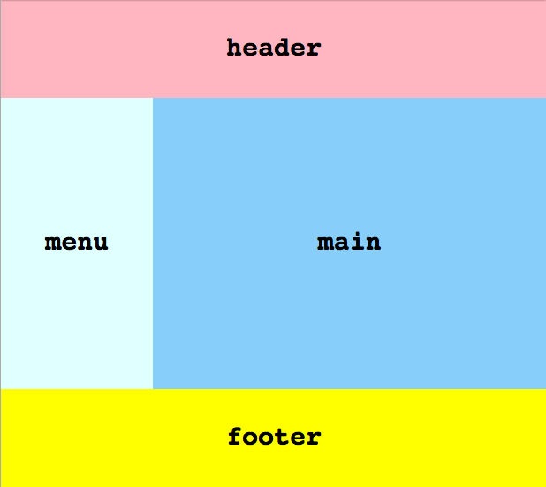
Intro to DIVs
<div>有用的原因之一是因为它们允许我们创建
自定义布局（页面布局）
用于我们的网站。
Header：页头
Menu：菜单
Main：主要内容
Footer：页脚

Slide 5
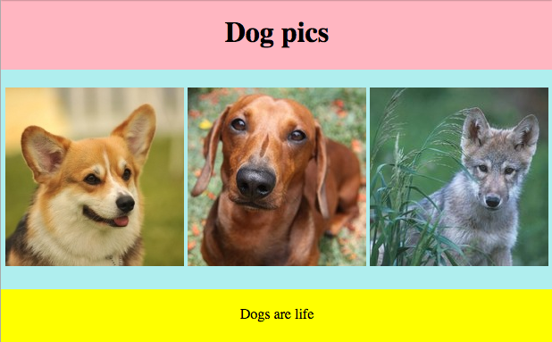
<body>
<div class=“页头">
<h1>Dog pics</h1>
</div>
<div class=“图片库">
…
</div>
<div class=“页脚">
<p>Dogs are life</p>
</div>
</body>
我们使用<div>来组织网站的各个部分

Slide 6
父子元素
当我们将嵌套HTML元素嵌套在另一个HTML元素中时，我们会创建父子关系。
<div class="header">
<h1>Dog pics</h1>
<p>A site about DOGS</p>
</div>
Parent
父元素
Children
子元素
Notes:
Teacher Notes
This slide is animated. Ask the students which element is the parent and which elements are the children. The answers will be revealed by the animation.

Slide 7
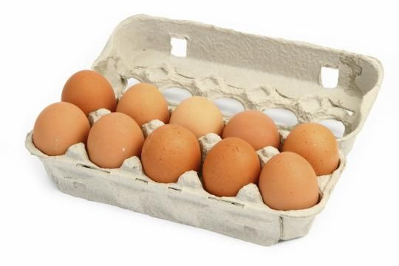
<div class="carton">
<p>egg</p>
</div>
b) <p class"egg">
<div class="cartons">
</p>
c)<div class="carton">
</div>
<p class="egg">
</p>
哪个正确地将鸡蛋egg元素嵌套在纸箱 carton div中？

Slide 8
哪里是嵌套？ 您能指出这段代码中的父子关系吗？
<html>
<head>
<title>Nesting Lesson</title>
</head>
<body>
<ul>
<li>Ducks</li>
</ul>
</body>
</html>
Notes:
Teacher Notes
There are 4 parent elements (html, head, body, ul) and 5 child elements (head, title, body, ul, li).
** make quick note about the importance of clean code here! What makes this easier to read? How have we represented tags that are nested in other tags?

Slide 9
HTML
Rendered layout
<div class="new-york">
<div class="manhattan">
<img src="empire-state.png">
<img src="central-park.png">
</div>
<div class="brooklyn">
<img src="coney-island.jpg">
</div>
<div class="queens">
</div>
<div class="bronx">
</div>
<div class="staten-island">
</div>
</div>
Notes:
Teacher Notes
This slide is animated! Each level of nesting is added, one click at a time.
This slide is a visual representation of what rendered divs can look like -- with content or without. As you click through the slide, talk through what is showing up inside which div.

Slide 10
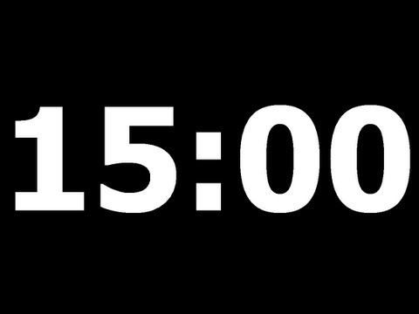
https://popcode.org/?snapshot=87af5bec-3214-4d2c-9ebd-5f94bb7f94a9
练习：您刚刚被聘为网络
DogBook开发人员！他们已经为您分配了您的第一个任务。
Notes:
Teacher Notes
Make sure to walk the students though the HTML and CSS in the starter code so they know that it's there and that they don't have to worry about it.
(old link: https://popcode.org/?gist=9a650947a506f231bc7af2471e43ccbd)

Slide 11
使用盒子模型来操纵页面上元素的间距（间隔）
Vocabulary: box model, content, padding, border, margin
Notes:
Coders should read aloud the objective.

Slide 12
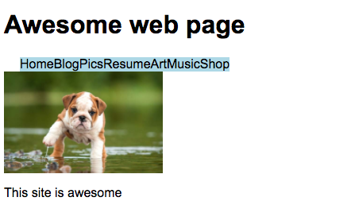
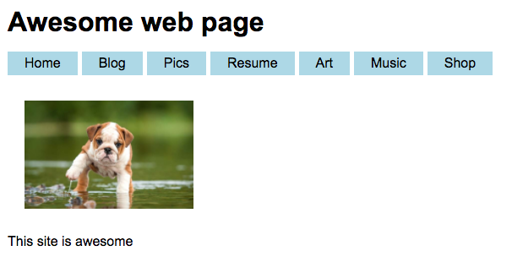
这些网站中哪一个看起来更好？ 为什么会有这种感觉？
Notes:
Teacher Notes:
-- Get students to verbalize the importance of adding space around elements
-- This site will be used during Guided Practice to show the box model in action

Slide 13
盒子模型
盒子模型描述了页面上每个HTML元素的设计和布局。
尽管您以前可能没有注意到它，但是每个HTML元素都是一个具有定义的边距（间隔），border（边），padding（填充）和content（内容）的框。
Notes:
Teacher Notes:
This is a lot of text and will be boring to students, make sure to read and explain this part but try to move forward.
Visual explanation on the next slide

Slide 14
盒子模型
Border
Padding
Margin
Content
Hello, world!
Hello, world!
Notes:
this is another way to look at it

Slide 15
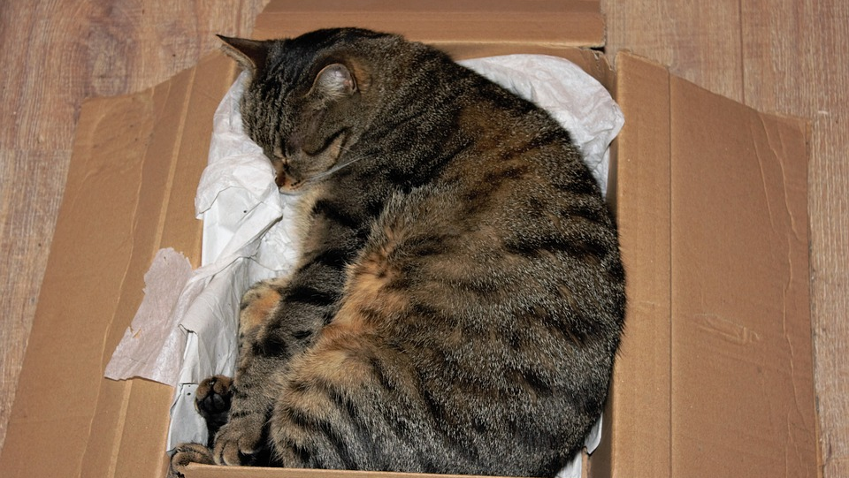
The Box Model
将盒子模型想像成包装盒。
Padding填充
Content 内容
Border边

Slide 16
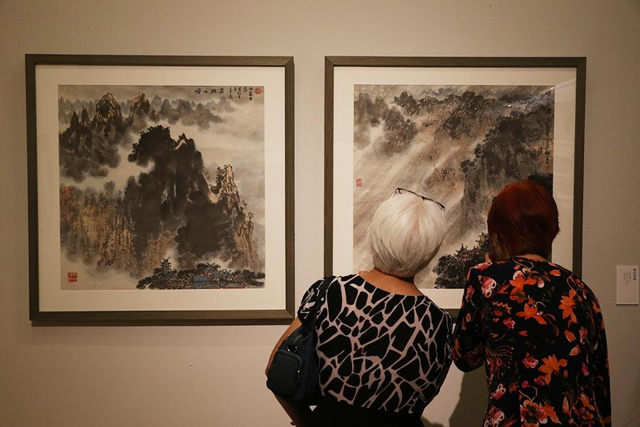
The Box Model
或艺术品
padding
Content
Margin（间隔）
border

Slide 17
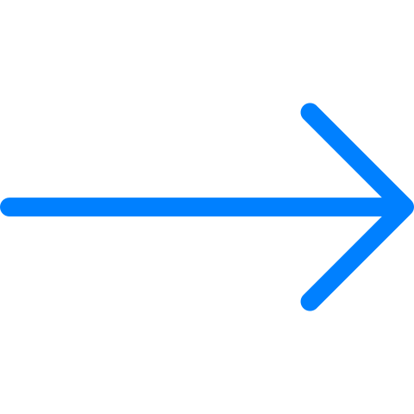
p {
padding: 10px;
border: 5px solid blue;
margin: 10px;
}
边距在元素之间创建了空间
The margin property here adds 10px of space outside of the p element
My Website
My Website
Notes:
Teacher Notes:
Code on the right is not representative of HTML look on the left
Give students time to write down notes Padding is grayed out to show that the padding is still 10px but we’re now focusing on border

Slide 18
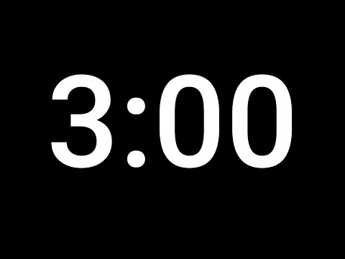
https://popcode.org/?snapshot=84f1ca3e-5de9-4a71-9c70-ebfc85c6af83
盒子模型演示
演示

Slide 19
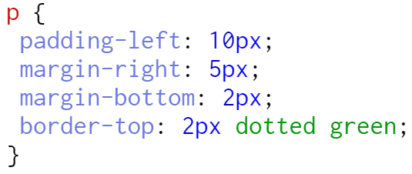
只改一边 of the margin, border or padding, use:
-top 顶,
-right 右,
-bottom 底, or
-left 左
Notes:
Teacher Notes:
Give students time to write down notes

Slide 20
让我们打开popcode 带和不带box模型的网站外观实验。
https://popcode.org/?snapshot=0814b2b9-c71e-4e1d-8825-d09b82d807be
Notes:
Demonstrate use of all box model properties including one-sided.
At minimum, add box model to <li>s and <h1>.
Let's make sure the divs above the image have some space between them.
Consider giving the navigation bar, header or the image a nice border.
What else would make this look nicer?

Slide 21
https://popcode.org/?snapshot=7ebe8d29-5607-40c5-9ceb-a748e43b3bc5
练习：
盒子模型
https://popcode.org/?snapshot=e5c29c1b-efaf-4ad2-bd98-ad1071df5e04
Notes:
Teacher Notes:
Test on the classroom pcs/laptops. Some of the elements might not display properly if the width of the window is too small. If that’s the case, try running the example on the board with only the Output panel displayed, while the students have only the CSS panel displayed.
The exercise introduces two types of borders not taught in this lesson. Students are encouraged to use the internet or ask the volunteers for help.

Slide 22
使用flexbox对齐网页上的元素
Vocabulary: align, justify-content, parent element, child element, , flexbox
Notes:
Coders should read aloud the objective.

Slide 23
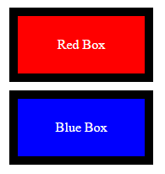
Connections
盒子模型允许您定义和样式化每个HTML元素。
今天，我们将学习如何使用flexbox在页面上对齐元素。

Slide 24
Flexbox
Flexbox是CSS属性的集合，允许您对齐和组织页面上的HTML元素。
它允许布局响应（或灵活）不同的屏幕尺寸。

Slide 25
Flexbox
为了使flexbox正常工作，您的HTML必须具有一个父（parent）元素和至少一个子（chile）元素。
<div class="outside">
<div class="inside">
<h1>Hello world!</h1>
</div>
</div>
parent element
child element

Slide 26
Flexbox
父元素告诉子元素如何通过CSS显示
<div class="outside">
<div class="inside">
<h1>Hello world!</h1>
</div>
</div>
parent element
child element

Slide 27
Using Flexbox
要打开flexbox，请使用属性display和值flex为父元素创建CSS规则。
HTML
CSS
<div class=“parent”> <div class= "child">
</div>
<div class="child">
</div>
</div>
.parent {
display: flex;
}

Slide 28
display: flex;
将父元素的显示属性设置为flex时，子元素将水平对齐。

Slide 29
Using Flexbox
现在我们启用了flexbox，我们可以告诉子元素如何使用justify-content在页面上对齐自己。
HTML
CSS
<div class="parent"> <div class="child">
</div>
<div class="child">
</div>
</div>
.parent {
display: flex;
justify-content: center;
}
使用justify-content属性，对齐页面上的子元素。

Slide 30
以下是对齐子元素的一些方法
justify-content: _______;

Slide 31
flex-start 开始
center 中间
flex-end 结束
space-between 中间留空
space-around 周围留空
justify-content: _______;

Slide 32
BuzzFeed的首席执行官已要求您重新设计他们无聊的导航栏！
系统会为您提供HTML，并且您必须使用CSS技能来展示新设计的3个版本！唯一的要求是每个菜单项都必须相邻放置。
Notes:
Use this activity to have students explore the various 'justify-content' properties and get comfortable using flexbox.

Slide 33
三种版本
Version 1:
Version 2:
Version 3:
Notes:
Use this activity to have students explore the various 'justify-content' properties and get comfortable using flexbox.
Remind students that they can make their samples look however they want… they do not need to copy the examples on the slide above

Slide 34
练习
https://popcode.org/?snapshot=3792c1c8-b41e-4516-9438-34ea37c90d87
Parent element:
align-items
align-content
flex-wrap
Child element:
flex
order
align-self
Notes:
Use this activity to have students explore the various 'justify-content' properties and get comfortable using flexbox.
Remind students that they can make their samples look however they want… they do not need to copy the examples on the slide above

Slide 35
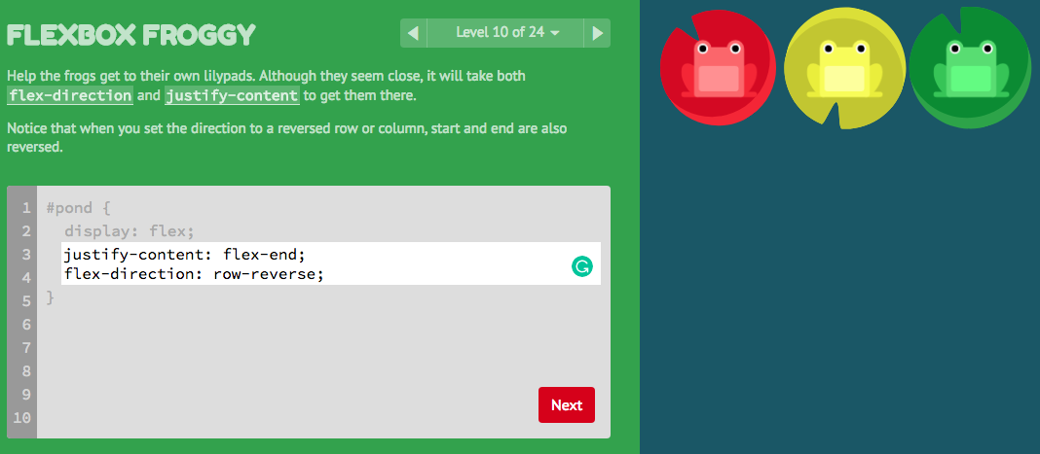
If you finish early, go to https://flexboxfroggy.com/#zh-cn to practice your Flexbox skills in this game!
https://flexboxfroggy.com/#zh-cn

